Slide 1
Modelling and Analysis of Human Behavior Impacts on Energy Systems during Crisis Events
Master Thesis of Isabella N. Grieser

Slide 2
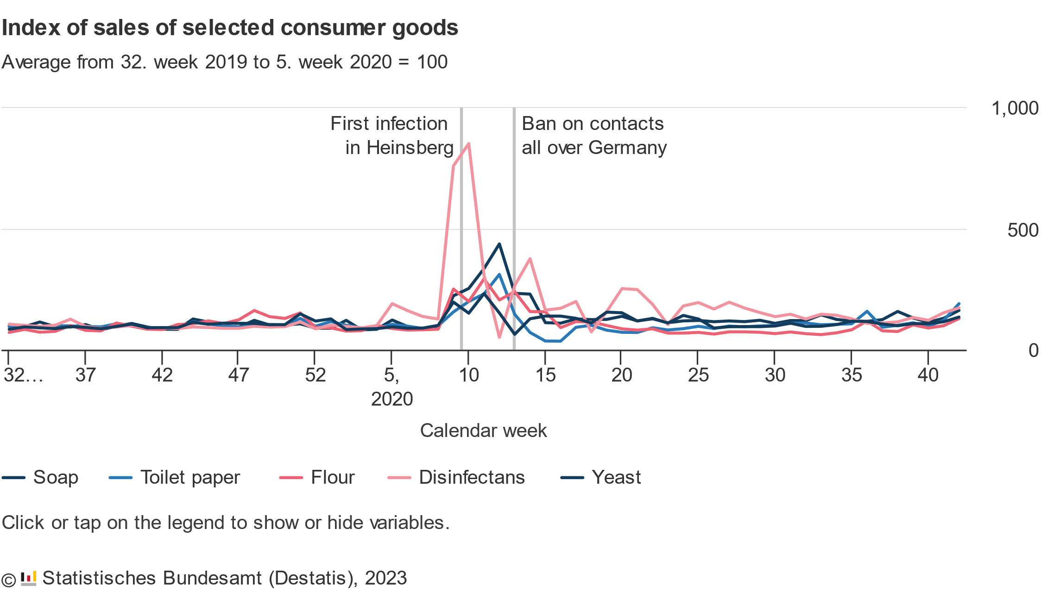
Panic Buying and Overconsumption became a very prominent topic during the COVID-19 Pandemic
Panic Buying: When consumers buy unusually large amounts of a product because of an unusual situation
During the COVID-19 Pandemic: People bought much greater number of disinfectants and soap in fear of the infectious disease.
Panic was amplified due to Information on Social Media

Slide 3
A few example Scenarios for changes in Consumption lead by Social Media affecting the Power Grid
Demand Response Scenario:
A false advertisement for reduced electricity price for a limited time spreads through social media.
“Disconnect” Scenario:
Conspiracy theorists want to send a message by disconnecting all electrical appliances by a specified time.
Wildfire Scenario:
Rumors of a wildfire lead to people leaving the city in masses. But, to leave the city, they need to charge their electric vehicles first.
Chemical Accident Scenario:
A chemical accident near a major city leads to all emergency channels recommending citizens to shower to remove harmful chemicals from their skin

Slide 4
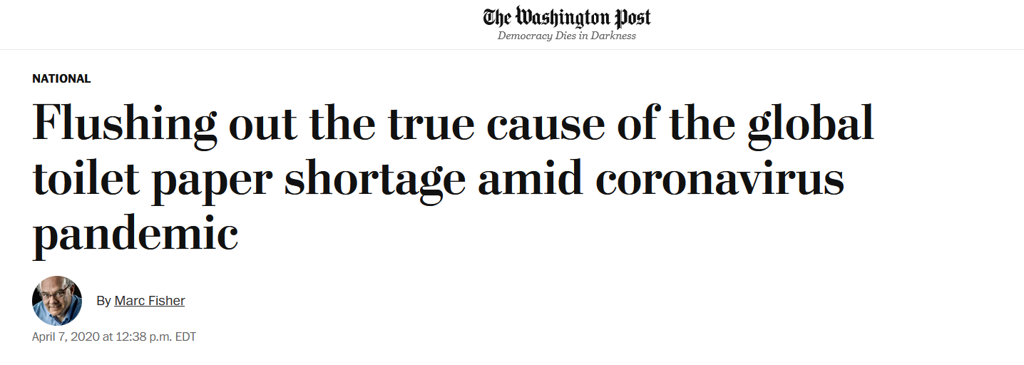
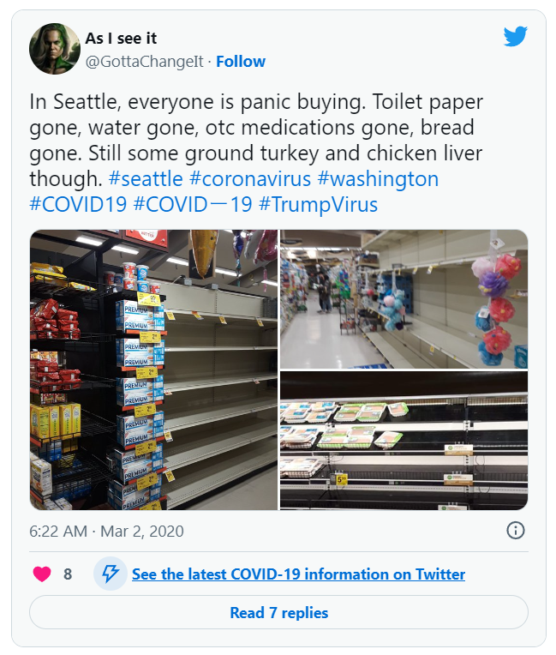
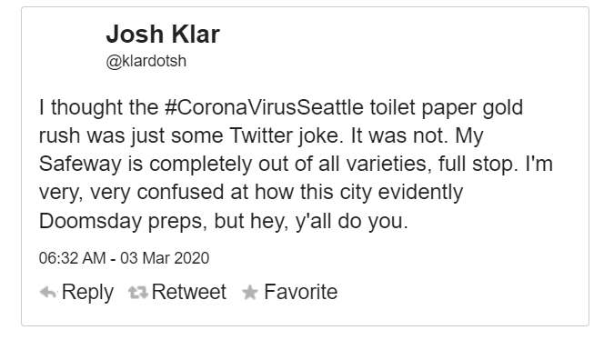
Consumption can be affected by Social Media
[2]
[1]
[2]

Slide 5
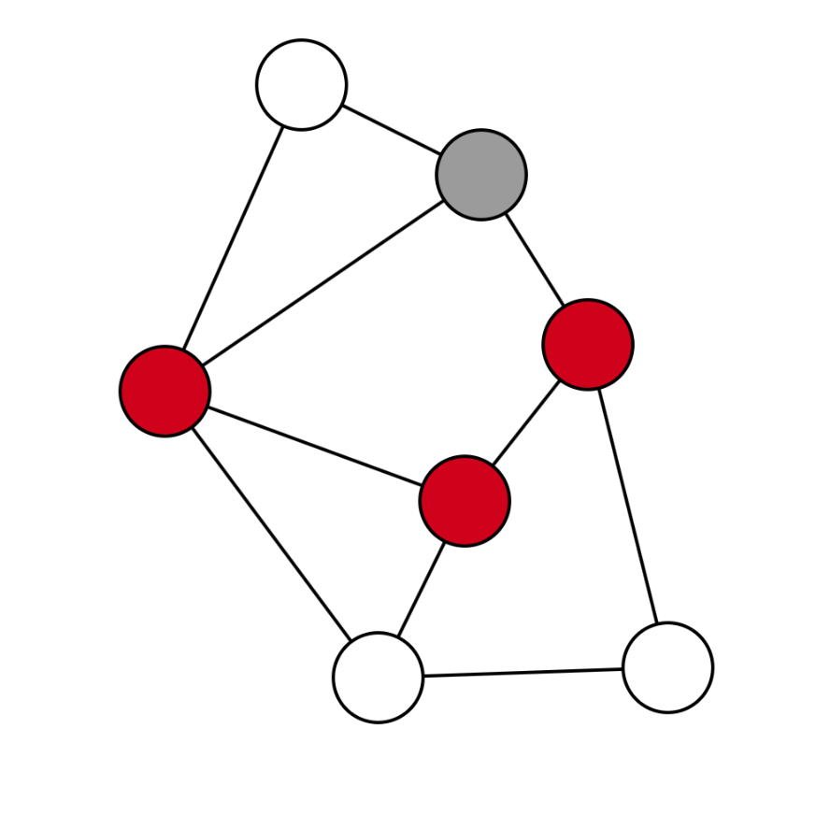

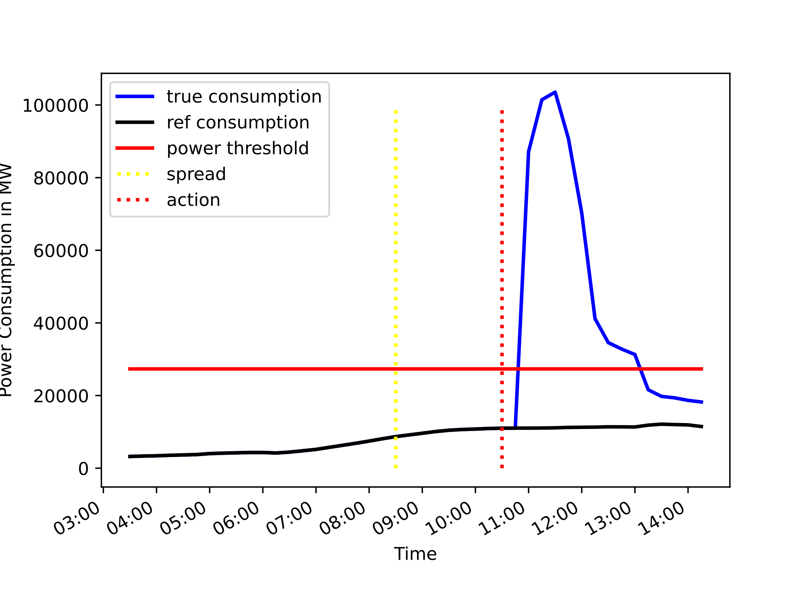
Idea: Analyze the Information Flow in Social Networks and check if it could affect the Power Grid
Create Social Media Graph
Model the Information Diffusion
Estimate the excess Power Demand

Slide 6

The Social Media Network Graph is modelled via Random Graph Algorithms
Graph model used to model social media networks ➔ Barabási–Albert model
Small world characteristic
Scale-free networks
Highly clustered
The SIR model is used to model the information propagation process [5]:
Three states:
Susceptible (S)
Infected (I)
Recovered (R)
Neighbors are predominantly infected ➔ graph node becomes infected
Neighbors are predominantly recovered ➔ graph node recovers

Slide 7
An epidemological Model is used to model the Information Propagation Process
The SIR model is used to model the information propagation process [5]:
Three states:
Susceptible (S)
Infected (I)
Recovered (R)
Neighbors are predominantly infected ➔ graph node becomes infected
Neighbors are predominantly recovered ➔ graph node recovers

Slide 8
Implementation of a Simulator to analyze the Effects on the Power Grid
Assumptions
Each node in the social media graph represents one (physical) household
The effect of the information may have a delayed response on the electrical grid
Simulation Steps
Start with one source of information
For each iteration step
Calculate the power used in the network
Propagate the information in the graph
Power Calculation
Each household may have electrical appliances and may activate them based on if they possess the specific appliances

Slide 9
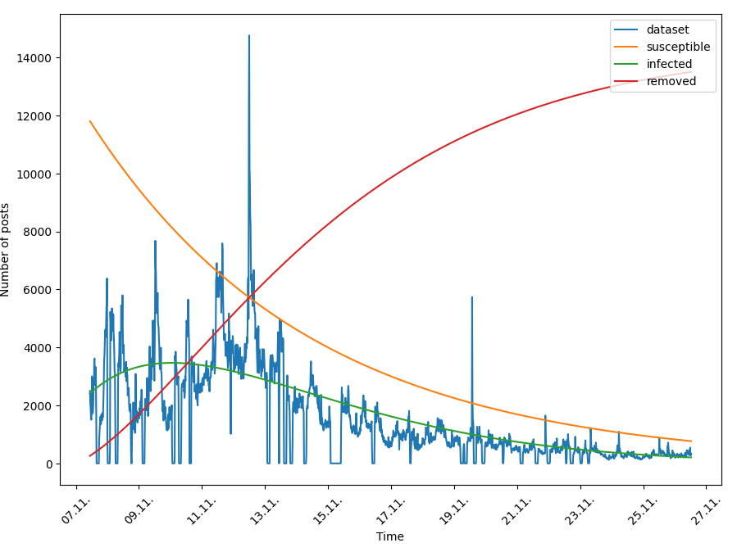
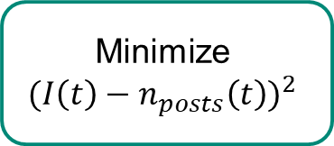
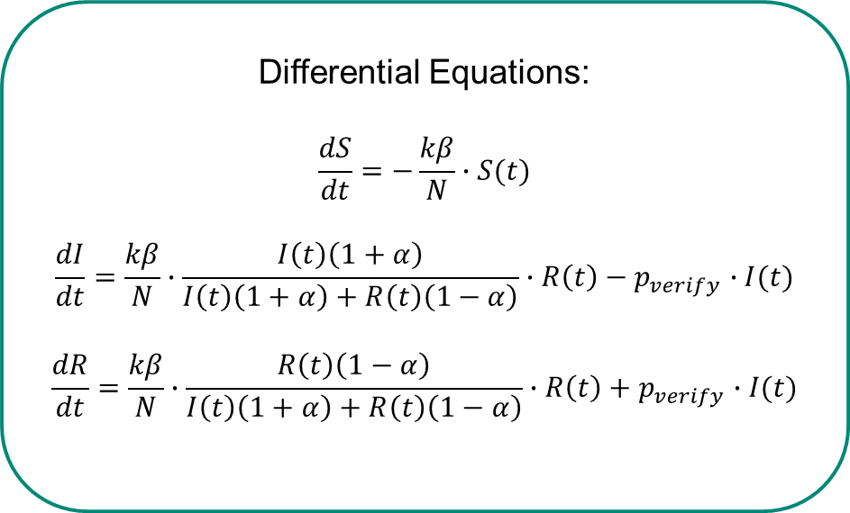
Social Media Data can be used to estimate Simulation Parameters
Count Social Media Posts over a Timespan
Smoothen Data Plot
Minimize
$${(I\left(t\right)−n_{posts}\left(t\right))}^{2}$$
Solve Differential Equations
Differential Equations:
$$\frac{dS}{dt}=−\frac{kβ}{N}∙S(t)$$
$$\frac{dI}{dt}=\frac{kβ}{N}∙\frac{I\left(t\right)\left(1+α\right)}{I\left(t\right)\left(1+α\right)+R\left(t\right)\left(1−α\right)}∙R\left(t\right)−p_{verify}∙I(t)$$
$$\frac{dR}{dt}=\frac{kβ}{N}∙\frac{R\left(t\right)\left(1−α\right)}{I\left(t\right)\left(1+α\right)+R\left(t\right)\left(1−α\right)}∙R\left(t\right)+p_{verify}∙I(t)$$

Slide 10
Proposal for a Prediction Framework
Collect Social Media Posts
Predict Model Parameters
Run Simulation
Power Demand critical?
Yes/No

Slide 11
Case Studies

Slide 12
Conclusion
Synchronization events caused by information on social media can be damaging to the power grid
Increasing adoption of new, highly power-consuming technologies increase the danger of synchronization

Slide 13
Questions?

